Slide 1
AI & BIG DATA EXPO EUROPE · AI DEVELOPER
ENTERPRISE
Beyond the Demo:
Building Trusted AI Agents
with MCP
A startup story, an enterprise reality,
and lessons from real implementations.
Constantine Grigoroff
Principal Data & AI Engineer · Shell Trading & Supply
STARTUP
20 OCT 2026 · RAI AMSTERDAM
AI DEVELOPER · 12:05–12:35

Slide 2
THE SET-UP
Fictional story. Real failure modes.
You’ve joined a nine-person startup.
Team of 9. Funding secured. Friday demo.
GOAL: CONNECT AN LLM TO REAL DATA THROUGH MCP
9
Trusted users. One identity path. One team.
A tool catalogue small enough to understand.
PEOPLE
ASSUMPTION DEBT
Small solutions are safe only while
their hidden assumptions remain true.
ACT I · PRODUCT
02

Slide 3
MAKE IT WORK
A practical MCP implementation
Host app
MCP client
Tool loop
MCP service
SQL policy
Data
ChatGPT / Copilot
Connection to server
Model chooses
next tool
25 narrow tools
Parse + authorise
Identity context
User identity on every call
Cached metadata
Catalogue + schemas
OUTPUT ADAPTERS
THE DESIGN PRINCIPLE
A deterministic spine around a probabilistic model.
Table
CSV
Excel
Chart
Map
The model interprets language. Code constrains execution.
STARTUP QUESTION: HOW DO WE CONTROL WHAT THE MODEL DOES?
ACT I · PRODUCT
03

Slide 4
FIND · CONNECT · VERIFY
Discovery outpaces approval
Registries
Community
Publisher
Allowlist
Runtime
Official + vendor-curated
Directories + search
Publisher + source
Approved versions
Scope + telemetry
DISCOVER
VERIFY
AUTHENTICATE
SCOPE
OBSERVE
Local
Remote
Users
DEV
HTTP
IDP
Credentials from the local environment
OAuth · bearer tokens · delegated credentials
Identity provider manages sign-in, roles and offboarding
REGISTRY ≠ ENDORSEMENT
ACT I · PRODUCT
04

Slide 5
BORED APES · MEME COINS · VERY CALM MARKETS
Customer acquisition: the VC arrives
PRIORITY CUSTOMER
BAYC FLOOR · ETH
TRUMP COIN · USD
~145
$73.43
~$4.8
~6.2
~$2.0
0.08
2021
2022
2026
JAN 25
DEC 25
SEP 26
VC
THE REQUIREMENTS CHANGE
“Can your agent analyse
my portfolio?”
Who can see my data? How long is it kept?
Can the agent take a durable action?
Nothing clarifies product priorities
like consequences.
Can I reproduce the answer?
CONTAINED BLAST RADIUS
Milestone illustration, not a daily price series.
ACT I · PRODUCT
05

Slide 6
FROM CAPABILITY TO CONTROL
Production expands the control surface
Identity & entitlements
Least privilege
Guardrails
Caller identity · dataset access
Read-only SQL · exact relations
Safe reads · reject writes · fail closed
Audit & telemetry
Evidence & provenance
Tests & release gates
Request · route · outcome
Logs are part of the security boundary
Dataset · SQL · source metadata
~470 automated tests
Unsafe requests must be rejected
STARTUP
Implement controls inside one product.
ENTERPRISE
Enforce controls consistently across every product.
TRUST = CONTROL + EVIDENCE
BRIDGE · PRODUCT → PLATFORM
06

Slide 7
WHAT BUILDERS REPORT
Security is not a workstream. It is the work.
50%
“Security and access control is the top challenge
for builders, cited by 50% of respondents.”
of surveyed MCP builders
Zuplo · State of MCP survey · fielded Nov–Dec 2025 · self-selected, no N published
cite security / access control
as their top challenge.
38%
blocked by security concerns
~24%
of respondents run servers
with no authentication
Authenticated ≠ authorised.
Issuer · audience · expiry · scope
MEASURED, NOT SELF-REPORTED: 40.55% OF 7,973 LIVE SERVERS EXPOSE TOOLS WITH NO AUTH · arXiv:2605.22333
IDENTITY · ACTION · RESOURCE · AUTHORITY — VALIDATE THE COMPLETE CONTEXT
ACT II · ENTERPRISE
07

Slide 8
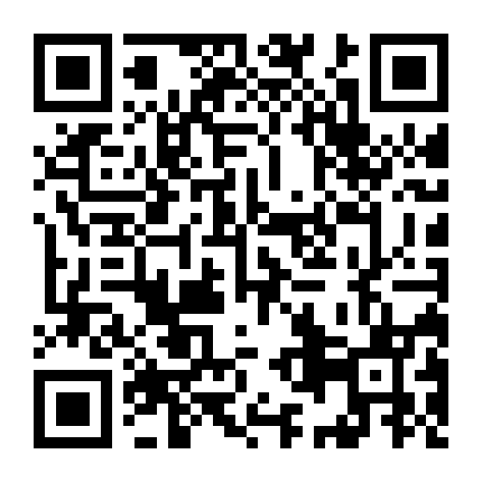
THE ENTERPRISE INFLECTION POINT
“This might take longer.”
PROJECT CHAT
TARGET: ENTERPRISE MCP GATEWAY
Founder
GATEWAY
Can we add enterprise SSO?
Client
identity · policy · audit
Engineer
Sure. That should be manageable.
Security
Authenticate once
Delegate identity
Great. Also delegated identity, user + non-user personas, entitlements, token exchange, audit, tenant isolation, offboarding…
Enforce policy
Unify telemetry
Engineer
arXiv:2608.10760 · production pattern
This might take longer.
OWASP MCP TOP 10
IMPLEMENTED: STATELESS HTTP
Stateless requests scale cleanly; session context remains optional.
ACT II · ENTERPRISE
08

Slide 9
FROM PLAUSIBLE TO REPEATABLE
Accuracy starts with routing and ends with evidence
1
Preserve the prompt
2
Explicit route
3
Trusted template
Original wording + request ID
Return one required next step
Embeddings select trusted SQL;
they do not invent it.
4
Hybrid retrieval
5
Schema + safety
6
Execute + evidence
70% lexical · 30% vector
Verify schema · parse · authorise
Read-only result + evidence
CONFIDENCE GATE
No confident match?
Ask or stop.
SERVER
CLIENT
LOW
HIGH
returns next step
calls next tool
Confidence protects accuracy; validation and authorisation protect safety.
REPEATABILITY: REQUEST · ROUTE · QUERY · DATA · EVIDENCE
ACT II · ENTERPRISE
09

Slide 10
LICENSE AND ACCESS
The data contract enters the routing layer
Separate relevance from permission.
VENDOR DATA AGREEMENT
This identity · this application · this purpose
AI / machine-learning use
Copying and retention
Access denied → stop
Terminal result · the client is told to stop
Storage location
Licensed identity and purpose
Bring compute to the data
Use of derived data
Minimise copies · process within the permitted boundary
The policy must shape routing
before the model sees the data.
Governed views · private inference · synthetic evaluation
CONTRACT TERMS BECOME POLICY INPUTS
ACT II · ENTERPRISE
10

Slide 11
TARGET STATE · CENTRAL GOVERNANCE
The platform around a domain MCP server
CHANNELS + PERSONAS
Chat / Teams
IDE
Agents
Automation
User + agent identities
ENTERPRISE AI / MCP GATEWAY
Auth + delegation
Baseline policy
Registry + discovery
Guardrails
Audit + telemetry
Common controls · domain-owned execution
DOMAIN MCP SERVERS
Domain semantics + execution rules
Domain data
Analytics
Domain tools
API access
PLATFORM TEAM
Platform tooling
Incident response
SYSTEMS + DATA
Existing APIs and data · MCP connects agents to these capabilities
Telemetry
CENTRAL GOVERNANCE · FEDERATED EXECUTION
ACT II · ENTERPRISE
11

Slide 12
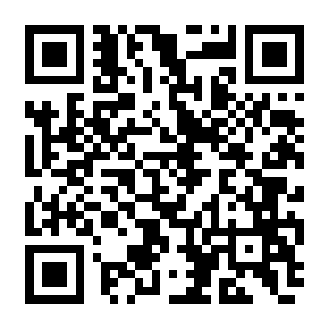
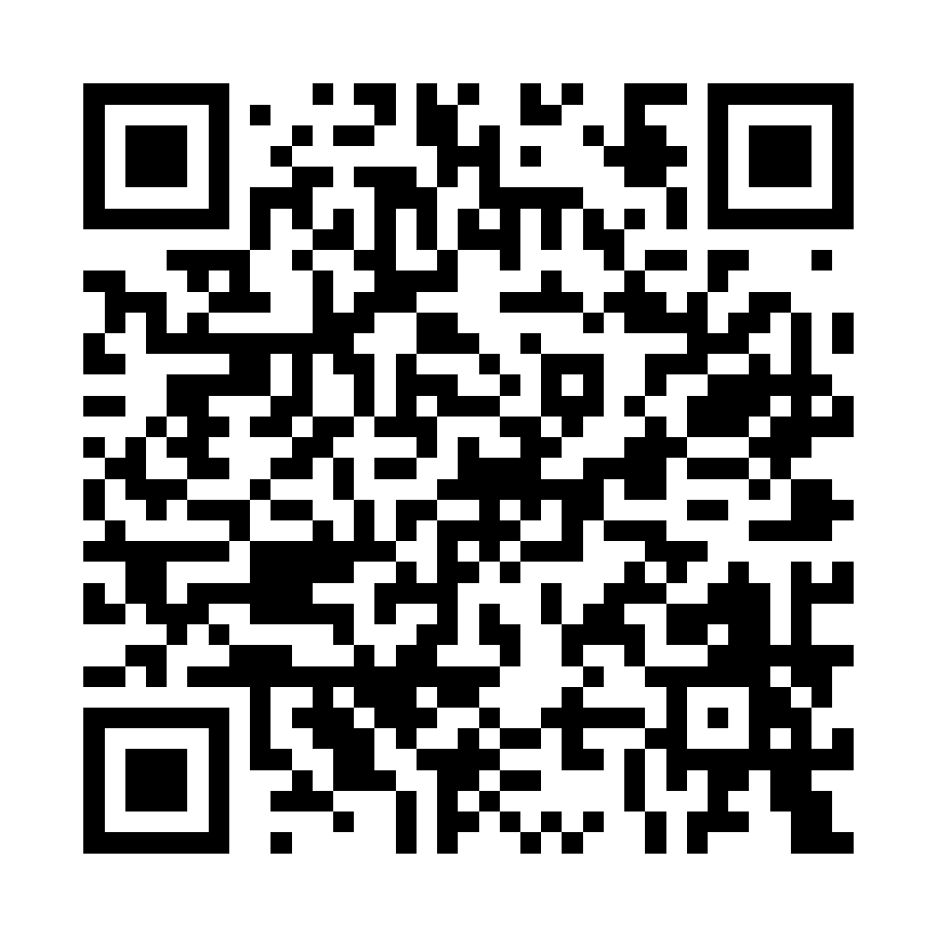
ONE IDEA TO TAKE HOME
The dividing line
STARTUP
ENTERPRISE
Control the model,
the route and the output.
Control every identity, tool and dataset,
then retain the evidence.
Tool loop · accuracy · UX · latency · cost
Authorization · licensing · policy · audit · operations
MAKE IT WORK
MAKE IT REPEATABLE
MAKE IT GOVERNABLE
Continue the conversation
kolygri.github.io
THANK YOU
Portfolio
LinkedIn
CLOSE
12

